Slide 1
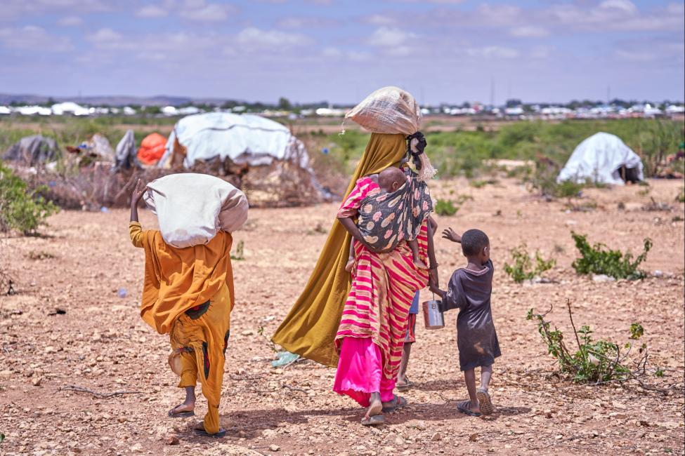
Migration and Climate Change in the Horn of Africa
Presentation at the IMPACT
International Workshop
Charleroi, Belgium
3 – 5 February 2026

Slide 2
Presentation Outline
About the Horn of Africa
Current snapshots of climate-induced displacements
Perceptions, research challenges and awareness level about Climate-induced migration
Recommendation, the way foreword

Slide 3
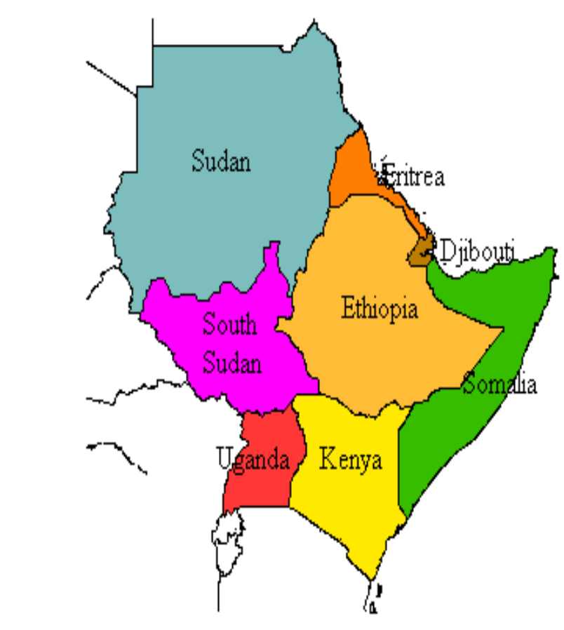
1.About the Horn of Africa (IGAD Region)
For purposes of this discussion, the Horn of Africa (HoA) refers to the IGAD sub-region consisting of Djibouti, Eritrea, Ethiopia, Kenya, Somalia, South Sudan, Sudan and Uganda
It stretches over an area of 5.2 million Km² of which 70% is made up of Arid & Semi Arid Lands (ASALs), which receives less than 600 mm of rainfall annually
Farm lands account for 7%, forests 19% & permanent pastures 28% of the total land area. The remaining 46 percent is relatively unproductive or marginal land.
It has a population of over 230 million people with a median age of 19 years and average growth rate of 2.6%/annum

Slide 4
1.About the HoA Region Contd…
HOA is a Strategic Region: location- near the Red Sea and Major Trade Routes; Cultural Diversity- many languages, religions, and Ethnic groups; Historical Significance- Ancient civilization, trade and migration)
The economic mainstay is Rain-dependent Agriculture, both livestock and crop production, which provides the basis for food supplies and export earnings, as well as over 80% of employment.
The region faces range of complex, interconnected and mutually reinforcing challenges (widespread poverty, political instability, conflicts and social unrest, economic challenges, environmental degradation, prolonged droughts and climate change, flooding, crop failures, limited access to productive resources, food insecurity, etc.)

Slide 5
Climate Change-Induced Migration
Climate change is reshaping the region’s migration landscape
Either voluntary-an adaptation strategy- or forced move, has become a formidable challenge for the region.
Its dynamics:
  Forced Vs voluntary
  Temporary Vs slow-onset
  Internal (Rural Urban in search of alternative livelihoods due to land degradation and water shortage)
  Cross-boarder within the region or to neighboring regions (for security or in pursuit of economic opportunity)
Climate Change leads to high rate of conflicts & displacement

Slide 6
2. Current Snapshot of Climate-Induced Displacements

Slide 7
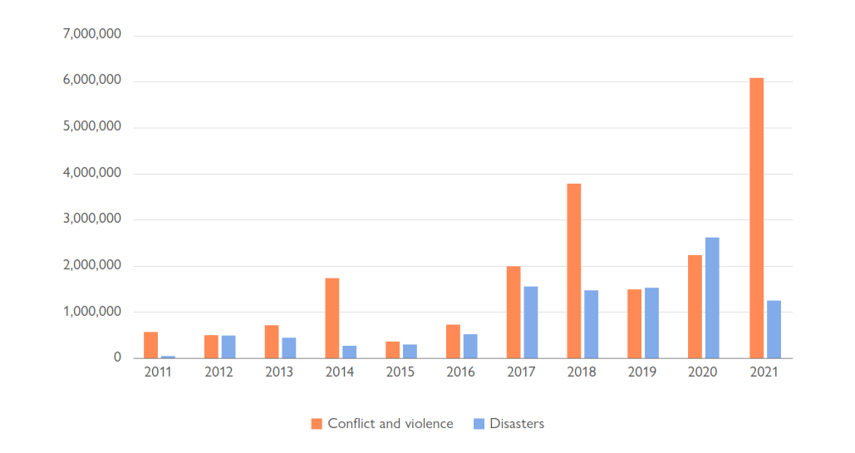
Trend of Internal Displacement in the HOA

Slide 8
Literature Language: Who are climate-induced displaced people?
A variety of terms exist to denote people displaced due to climatic events or disasters.
Terms common in literature include:
  Climate Migrant
  Environmental Migrant
  Climate Refugee
  Climate-Induced Migrant
  People forcibly displaced by climate change
In contrast to the term ‘refugee’, which is a legal definition defined by the 1951 Refugee Convention and enshrined in international law, terms such as ‘climate refugee’ or ‘climate migrant’ do not obligate states to provide protection or assistance.
This means that climate-induced displaced people have traditionally been ineligible for refugee status.

Slide 9
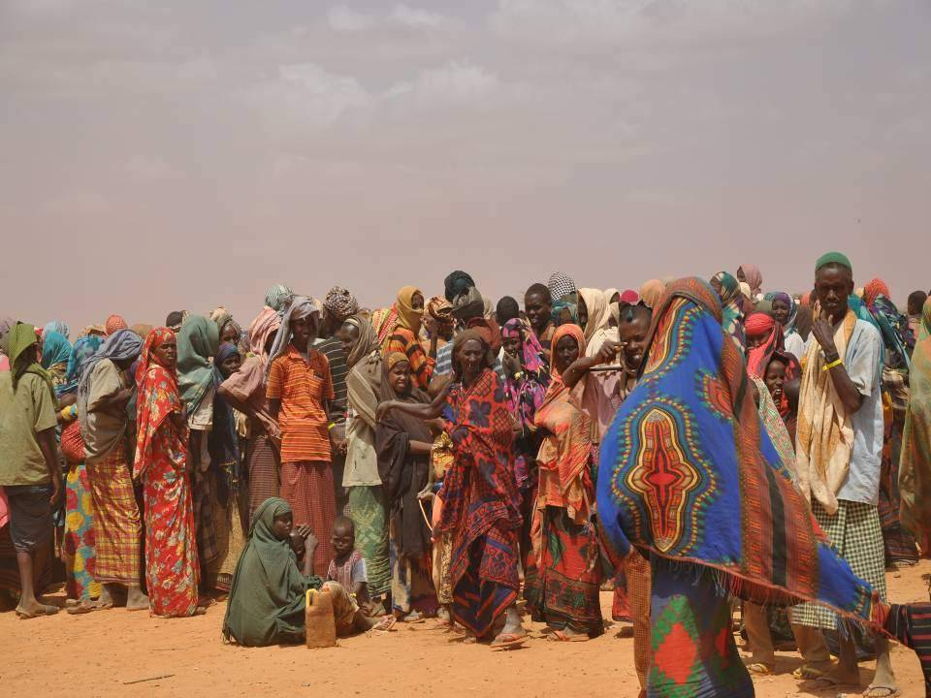
Image: People displaced by drought in Somalia wait to be registered at a refugee camp in Ethiopia. Photo Credit: Cate Turton/Department for International Development, CC BY 2.0, via Wikimedia Commons.
Extant international laws leave millions unprotected

Slide 10
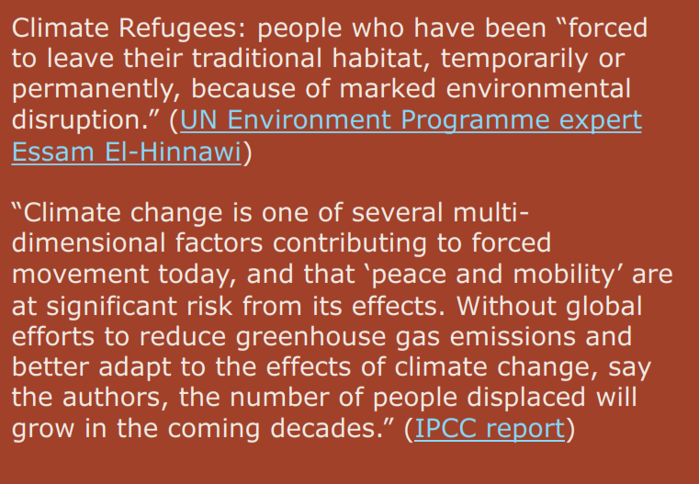
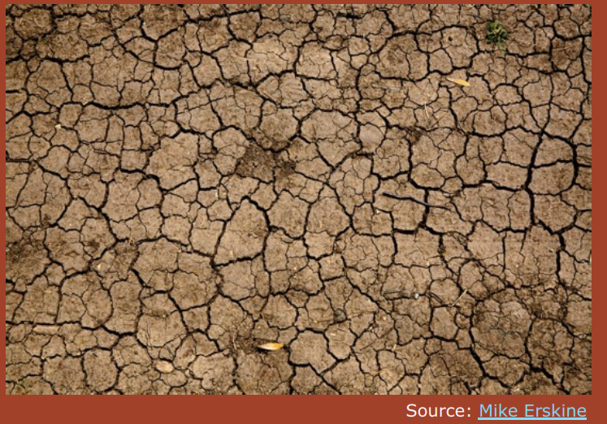
Climate Refugees - the world’s Forgotten Victims

Slide 11
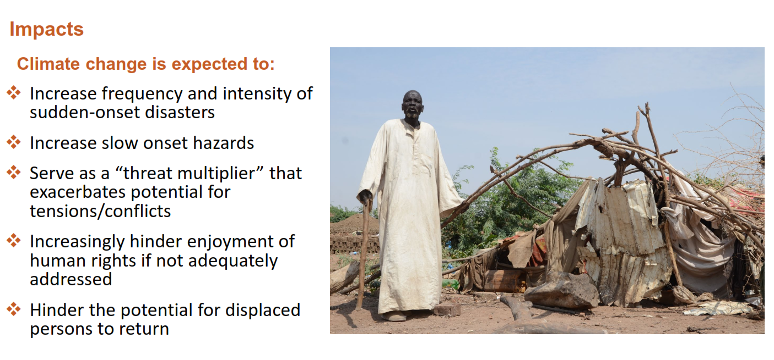
Stronger on the poorest groups, due to their low adaptive capacity to respond and their high degree of vulnerability

Slide 12
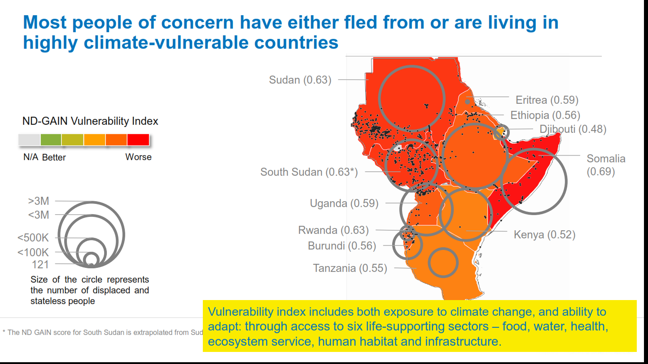
Climate change vulnerability

Slide 13
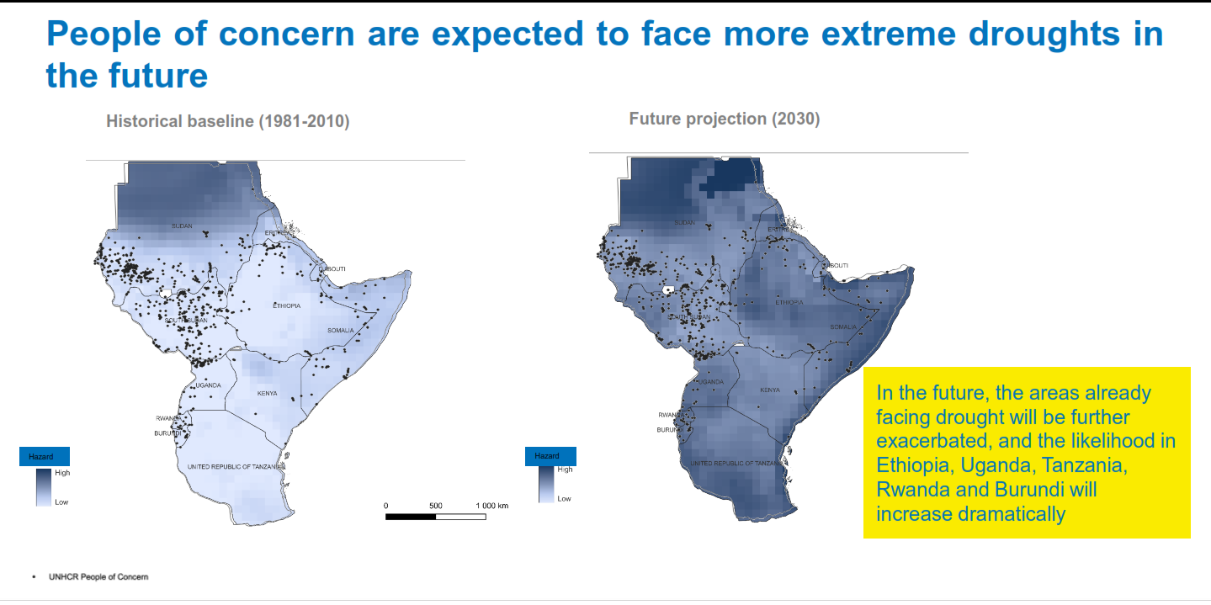
Precipitation

Slide 14
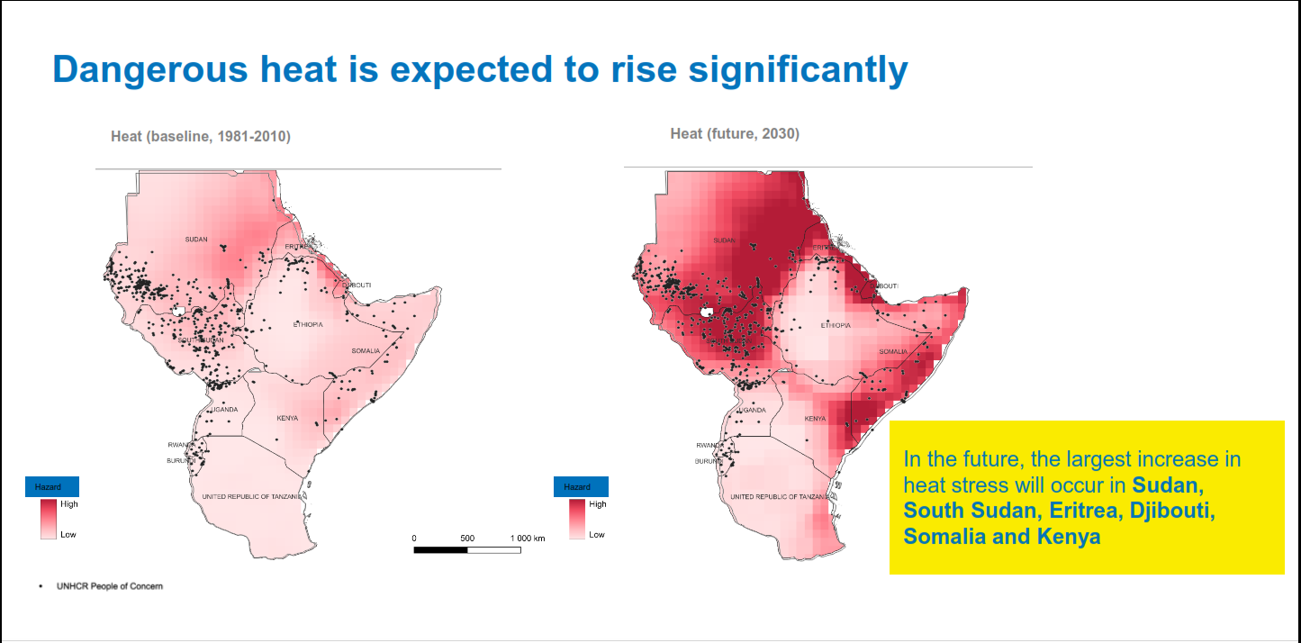
Temperature

Slide 15
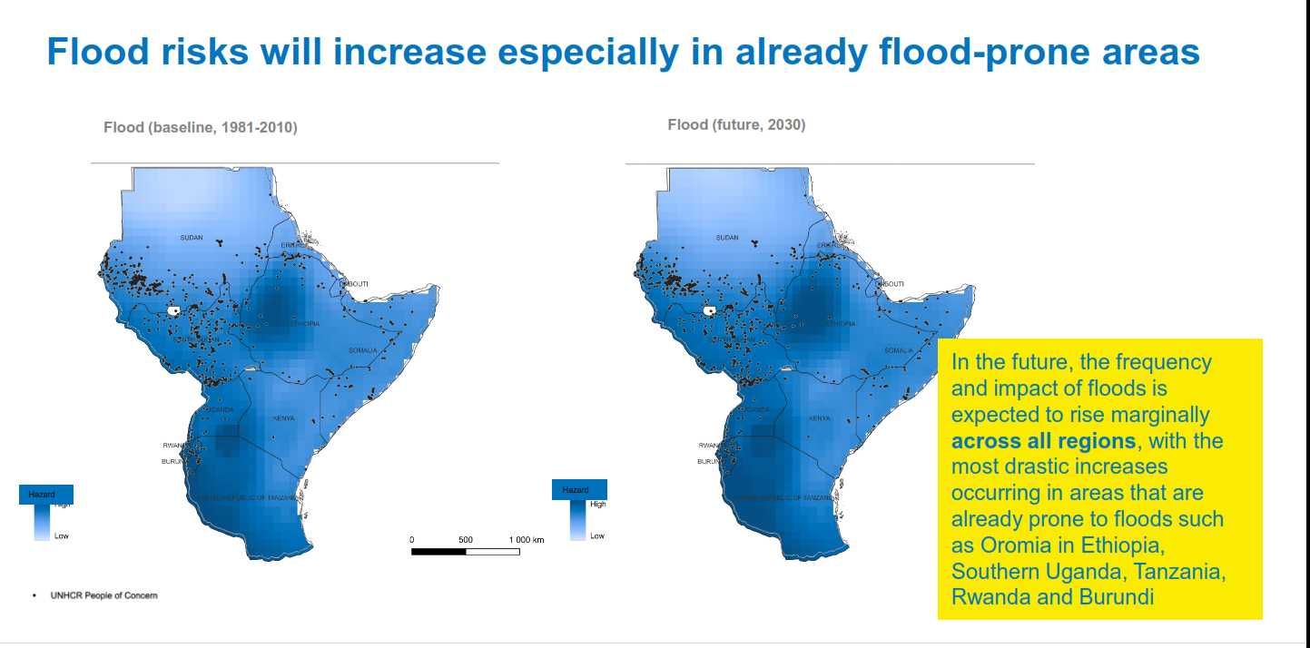
Flooding

Slide 16
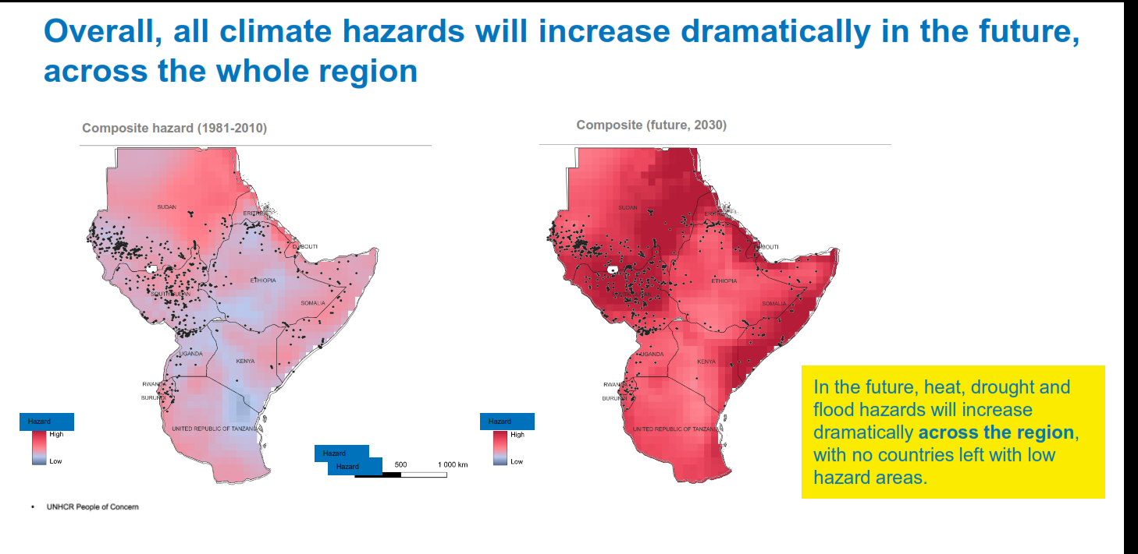
Climate Hazards (droughts, floods, heat waves, cold waves, storms, cyclones/hurricanes, sea level rise, wildfires, etc.)

Slide 17
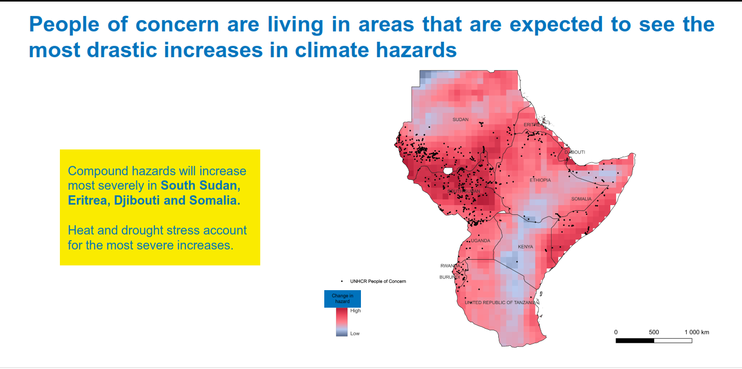
Vulnerability to Climate Hazard

Slide 18
3. Perceptions, research challenges and awareness level about Climate-induced migration
3.1 Is Climate-Induced Migration Temporary?
Two Views:
A) Short-Distance and Internal
  lack the resources to engage in long-distance migration, they are more likely to move within their own country or to nearby urban areas
  People believe that unsustainable measures such as working longer hours and selling assets can improve the situation
B) Climate migrants are forced to permanently migrate
  Unfortunately, as CC lengthens the duration of these periods, many climate-induced displaced people are losing their ability to engage in temporary migration and are forced to permanently migrate (Call and Gray, 2020)

Slide 19
3.2 Limited data on climate-induced forced migration
Quantifying environmental migration is challenging given the multiple drivers of such movement, related methodological challenges, and the lack of data collection standards.
Some quantitative data exists on population displacement with a country, and to a lesser degree across borders, due to natural hazards.
However, for migration due to slow-onset environmental processes, such as drought or sea-level rise, most existing data is qualitative and based on case studies with few comparative studies (migration data portal 2021)

Slide 20
3.3 Limited Awareness and Communication in Climate-induced migration
Limited awareness and fragmented communication regarding the link between CC and migration present significant barriers to developing effective, proactive policies and, supporting vulnerable populations.
While CC is a known driver of migration, the complex, often indirect, relationship between environmental hazards and human mobility is under-researched, poorly communicated, and often excluded from mainstream climate dialogues.

Slide 21
3.4 AWARENESS AND COMMUNICATION ABOUT CLIMATE CHANGE AND MIGRATION IN THE EU: A FOCUS ON BELGIUM, GREECE, ITALY AND SPAIN
Knowledge on climate change and climate change induced migration

Slide 22
3.5 Source of Information About Climate Change

Slide 23
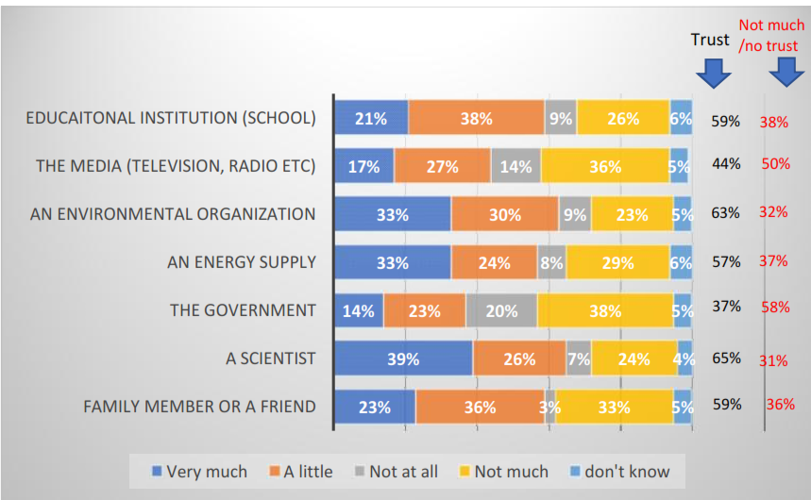
3.6 Trust about information on climate change

Slide 24
3.7 Can anything be done to tackle climate change

Slide 25
3.8 Responsibility to address effects of climate change

Slide 26
3.9 Extent to which climate change and climate induced migration were addressed in schools

Slide 27
3.10 Causes of Migration

Slide 28
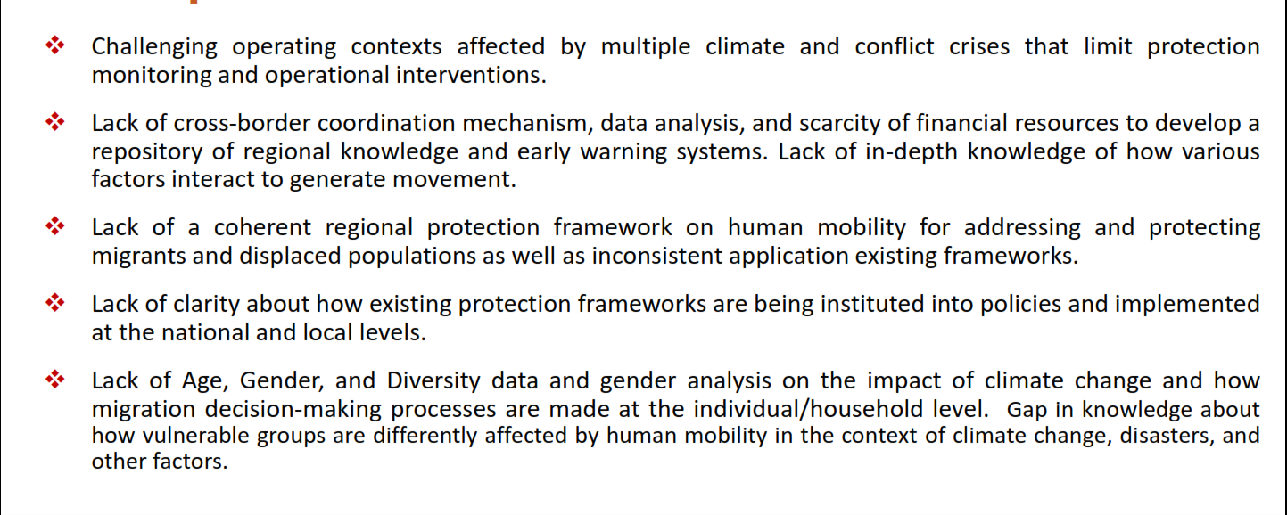
Gaps and Needs

Slide 29
4. FOCUS FOR THE FUTURE?
Achieving a resilient society – where people can adapt in place and thrive, or migrate with dignity to areas of higher opportunity – should be an important part of meeting national development goals.
Take a long-term perspective on how to reduce vulnerability and ENHANCE resilient, in order to reduce the number of distressed people forced to move as a result of climate change.
Develop holistic and enduring strategies that cater to the needs of affected communities and foster resilience over the long term
Investment in resilient infrastructure, Sustainable NRM, enhancing the adaptive capacities of local communities

Slide 30
4. FOCUS FOR THE FUTURE
THE NEED FOR LIVELIHOODS ASSISTANCE AND LIVELIHOODS DIVERSIFICATION AT THE SOURCE
Livelihoods are one of the key needs of people uprooted due to CC– similar to most other forcibly displaced people.
In many instances, climate-induced displacement occurs as a type of rural-urban migration- often farmers or pastoralists and for this reason may need Reskilling/retraining in order to find work in urban areas.
UNHCR’s Special Advisor on Climate Action explains,
“Displaced populations often have precarious livelihoods, reduced or no access to social safety nets and health services. These vulnerabilities are exacerbated for those in ‘climate hotspots’, or where livelihoods are already at risk due to CC & env’tal degradation (UNHCR 2020).

Slide 31
4. Focus for the future
Mainstream and integrate climate sensitivity
Democratize climate awareness and prioritize gender inclusion
Implement policies and programmes that facilitate adaptation and risk management as opposed to crisis management
Create international advocacy coalitions that recognize the special needs of climate-induced migrants, for many of whom returning home may never be an option as the climate crisis continues
Engage local governments and other municipal actors in planning and decision making around addressing climate induced forced migration
Establish a regional protection framework on human mobility in the context of climate change
Enhance data and evidence through further research

Slide 32
Thank you

